Slide 1
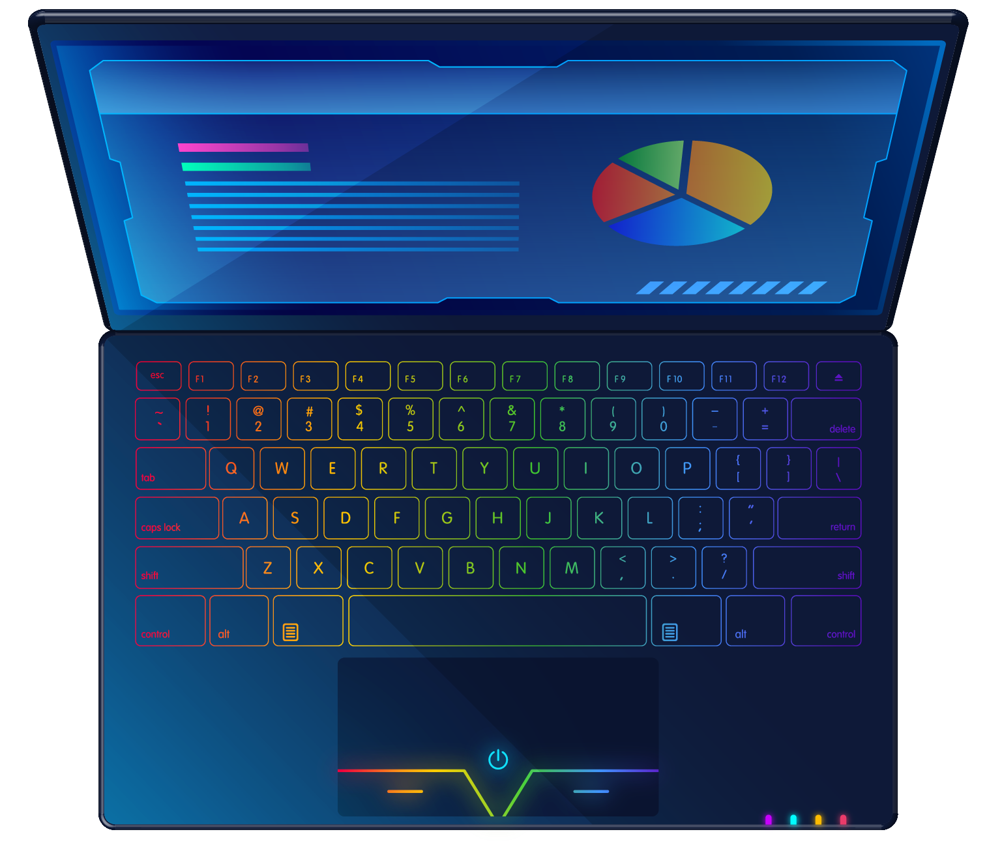
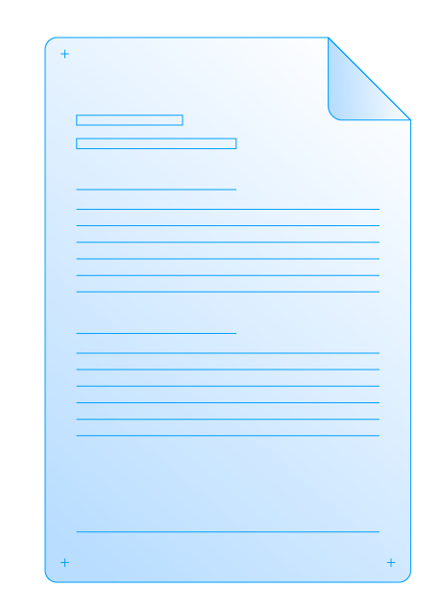
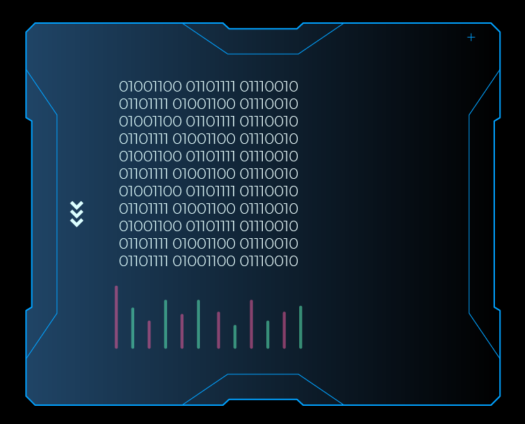
AGILE
VS
WATERFALL:
A COMPARATIVE ANALYSIS

Slide 2
UmairSolangi Ibrahim Khaliullah M Ahmed Asim Fiza Ismail
Group Members

Slide 3
Tobin J Lehman, AkhileshSharma , “Software Development as a service: Agile Experiences”, in annual SRII Global Conference(2011).
Ahmed, S. Ahmad, Dr. N Ehsan, E. Mirza, S.Z. Sarwar,“Agile Software Development: Impact on Productivity and Quality”, in the Proceedings of IEEE.
Boehm and R.Turner, “Balancing Agility and Discipline: A Guide for the Perplexed, Addison, Wesley,2003.
Eason, Oriana Karina, "Information Systems Development Methodologies Transitions: An Analysis of Waterfall to Agile Methodology" (2016).
Ahmed Lawal1, Richard Chukwu Ogbu2 , “The Comparative Analysis of Agile and WaterFall Software Development Methodology”.
Agile Methodologies: Working Mechanism with Pros and Cons, Rajiv Kumar, GIAN JYOTI E-JOURNAL, Volume 4, Issue 2 (Apr-Jun 2014) .
Advantages and Disadvantages of Waterfall Model.
Reference:

Slide 4
Introduction:
Brief Overview of Agile and Waterfall
Agile and Waterfall are two distinct project management methodologies used in software development.
Agile emphasizes flexibility and collaboration, while Waterfall follows a structured, sequential approach.
Significance of Methodology in Software Development
The chosen methodology significantly influences project outcomes and success.
Understanding the differences helps in making informed decisions for effective software development.

Slide 5
Why Methodology Matters
Impact on Project Success
The methodology employed can impact project success in terms of timelines, budget, and stakeholder satisfaction.
Different methodologies offer unique advantages and challenges.
Alignment with Project Requirements
Selecting a methodology that aligns with project requirements is crucial for efficient development.
Tailoring the approach to the project's nature enhances the likelihood of success.

Slide 6
Agile Methodology - Overview
Brief explanation of Agile principles
Agile is an iterative and flexible approach that accommodates changes throughout the development process.
It values customer collaboration, responding to change, and delivering functional increments.
Focus on flexibility, collaboration, and iterative development
Flexibility: Agile allows for adapting to changing requirements even late in the development cycle.
Collaboration: Emphasizes regular communication and collaboration among team members and stakeholders.
Iterative Development: Delivers the project incrementally in short cycles.

Slide 7

Waterfall Methodology - Overview
Brief explanation of Waterfall principles
Waterfall follows a sequential, linear approach with distinct phases, each building upon the previous one.
It emphasizes comprehensive documentation and has clear milestones.
Emphasis on sequential phases and structured approach
Sequential Phases: Waterfall progresses through distinct phases: requirements, design, implementation, testing, deployment.
Structured Approach: Each phase has specific objectives, and progress is measured against predefined milestones

Slide 8
Agile: Advantages:
:
Flexibility in Requirements:
Agile allows changes in project requirements, even late in the development process, making it well-suited for dynamic projects.
Customer Satisfaction:
Continuous client involvement ensures that the delivered product aligns closely with customer expectations, leading to higher satisfaction.
Early Delivery of Incremental Value:
Agile delivers functional increments of the product in short cycles, allowing stakeholders to see tangible progress early in the project.
Adaptability to Changes:
Agile embraces changes and adapts to evolving circumstances, fostering a responsive approach to project modifications.

Slide 9
Agile: Disadvantages:
:
Incomplete Initial Requirements:
Agile requires evolving requirements, and if initial requirements are unclear, it can lead to challenges in project planning.
Client Involvement Demands:
Continuous client collaboration may be demanding, and if clients are not available, it can impact project progress.
Scope Creep Risk:
The flexibility of Agile increases the risk of scope creep, where additional features are introduced, impacting timelines and budgets.
Documentation Challenges:
Agile focuses on working software over comprehensive documentation, which can lead to chall

Slide 10
Project Using Agile Methodology:
Mobile App For Tracking And Managing Employee Kpi’s
Project Kickoff:
The development team, product owners, and stakeholders meet to discuss the goals and features of the employee KPI tracking app.
A backlog is created, outlining features such as KPI entry, performance visualization, and user authentication.
Sprint 1: Planning and Development:
The team selects a subset of features for the first sprint (e.g., user authentication and basic KPI entry).
Daily standup meetings are held for progress updates, and developers work iteratively to implement features.
Continuous testing is performed throughout the sprint.
Sprint Review and Retrospective:
At the end of the sprint, the team showcases the implemented features to stakeholders.
Feedback is collected and incorporated into the next sprint.
The team reflects on the sprint in a retrospective, identifying improvements.

Slide 11
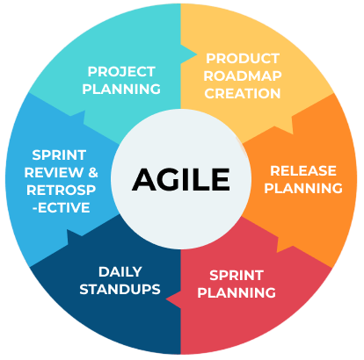
Sprint 2: Planning and Development:
Based on feedback and priorities, the team selects the next set of features (e.g., advanced KPI analytics).
The process repeats with regular reviews, retrospectives, and adjustments.
Continuous Iterations:
The team continues with successive sprints, adding new features and refining existing ones based on feedback.
Agile allows for flexibility, so changes to requirements can be accommodated easily.
Final Release:
After several iterations, the app reaches a state where it meets all the requirements.
The final release is deployed, and ongoing maintenance may continue with
smaller updates.

Slide 12
Waterfall: Advantages:
Predictable Project Timelines:
Waterfall's sequential approach allows for the creation of predictable project timelines from the start.
Clear Project Phases:
Well-defined project phases ensure a structured approach to development, with each phase building upon the previous one.
Comprehensive Documentation:
Each phase in Waterfall emphasizes documentation, resulting in a comprehensive record of project specifications and progress.
Easier Project Management:
The linear nature of Waterfall makes project management and tracking progress relatively straightforward.

Slide 13
Waterfall: Disadvantages:
Limited Flexibility:
Waterfall's rigid structure provides minimal room for adapting to changes, making it challenging to respond to evolving requirements.
Late Issue Identification:
Issues may not be identified until the testing phase, making it difficult and costly to address problems that have existed throughout the project.
Extended Project Timelines:
Changes or unforeseen challenges late in the project can result in significant delays as the project progresses through predefined phases.
Unclear Client Expectations:
Limited client involvement may lead to misunderstandings or misalignments with client expectations.

Slide 14
Project Using Waterfall Methodology:
Mobile App For Tracking And Managing Employee Kpi’s
Requirements Gathering:
A detailed document is created outlining all the requirements for the employee KPI tracking app, including user stories and functionality specifications.
System Design:
Designers create a comprehensive system architecture based on the documented requirements.
This might include mock-ups of the app interface and detailed technical specifications.
Implementation:
Developers begin coding the app according to the design specifications.
The entire app is built as a single unit without incremental releases.
Testing:
The entire app undergoes testing, including unit, integration, and system testing.
Bugs and issues are addressed before moving to the next phase.

Slide 15
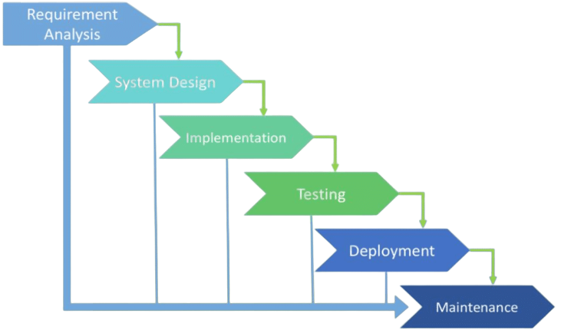
Deployment:
Once testing is successful, the app is deployed to the production environment as a complete, fully functional product.
Maintenance:
After deployment, the app enters the maintenance phase where any post-release issues are addressed.
Updates or new features require a new
development cycle.

Slide 16
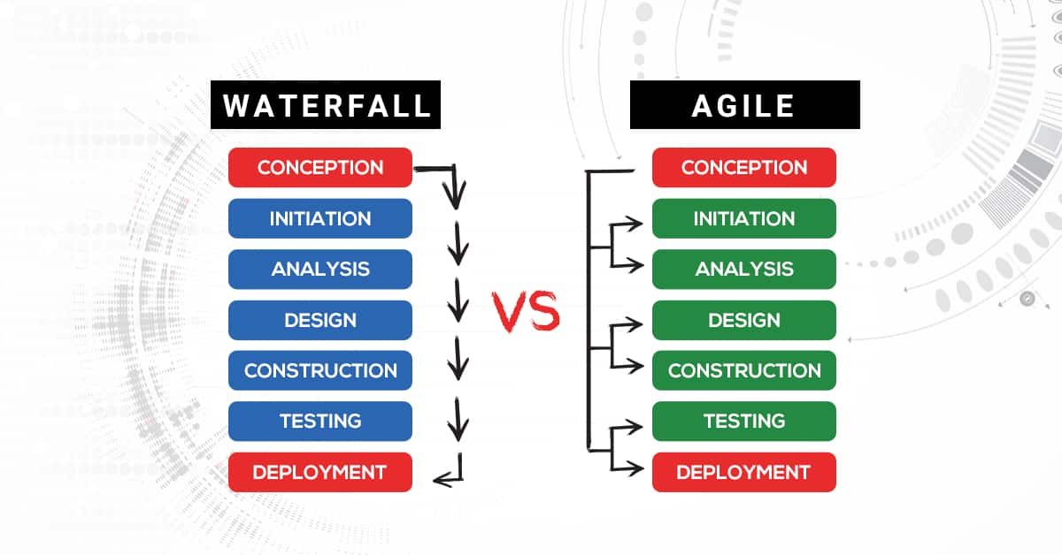
Comparative Analysis

Slide 17
Key Issues in Results
Challenges Identified in Agile:
Scope Creep: Rapid changes and additions to project scope may occur.
Limited Documentation: Agile may lack comprehensive documentation, impacting future understanding.
Resource Allocation: Dynamic nature of Agile projects may pose challenges in resource management.

Slide 18
Key Issues in Results Cont…
Challenges Identified in Waterfall:
Limited Adaptability: Rigid structure makes it difficult to accommodate changes during development.
Extended Timeframes: Going back to previous stages can lead to prolonged project timelines.
Stakeholder Involvement: Limited continuous feedback due to stakeholder engagement at specific project phases.

Slide 19
Explanations for Results
Root Causes of Agile Challenges | Root Causes of Waterfall Challenges
Dynamic Requirements: Frequent changes in project scope and requirements contribute to challenges in managing scope creep. | Rigid Structure: The inflexibility of the Waterfall model is a fundamental cause, making it challenging to adjust to evolving project needs.
Emphasis on Individuals over Processes: Overreliance on individual interactions may lead to insufficient documentation and knowledge sharing. | Sequential Dependencies: Dependencies on completing one phase before moving to the next can result in extended project timelines.
Flexibility Strain: The inherent adaptability of Agile can strain resource allocation and project management. | Limited Stakeholder Involvement: The model's structured approach limits continuous stakeholder feedback, hindering adaptability to changing requirements.

Slide 20
Implications for Software Development
Choosing the Right Methodology:
Project Complexity: Assess the complexity – Agile suits dynamic and evolving projects, while Waterfall is better for straightforward, stable projects.
Adaptability Needs: Consider the need for adaptability – Agile accommodates changes more easily, while Waterfall is rigid and sequential.
Risk Tolerance: Evaluate risk tolerance – Agile allows for early identification and mitigation, while Waterfall addresses risks in predefined phases.
Client Involvement: Assess client involvement preferences – Agile involves clients continuously, ensuring their input, while Waterfall may have less frequent interactions.

Slide 21
Implications for Software Development Cont...
Impact on Stakeholders and Outcomes:
Stakeholder Engagement (Agile): Agile ensures continuous stakeholder engagement, promoting collaboration and responsiveness to evolving needs.
Stakeholder Involvement (Waterfall): Waterfall involves stakeholders mainly at the beginning and end, potentially leading to less client interaction throughout the development process.
Outcome Predictability (Waterfall): Waterfall provides clearer project timelines and comprehensive documentation, enhancing predictability.
Adaptability and Responsiveness (Agile): Agile allows for quick responses to changing requirements, fostering adaptability and responsiveness throughout the project.

Slide 22
Recommendations
Recommendations for Agile Projects | Recommendations for Waterfall Projects
Emphasize Collaboration: Foster continuous collaboration among team members and stakeholders to accommodate evolving requirements effectively. | Thorough Planning: Invest significant time in detailed planning at the outset to minimize the need for changes and ensure a smooth progression through project phases.
Prioritize Communication: Maintain open and transparent communication channels to ensure all team members are well-informed and aligned with project goals. | Comprehensive Documentation: Prioritize comprehensive documentation at each stage to facilitate understanding, maintenance, and future development.
Iterative Reviews: Conduct regular iterative reviews to assess progress and adapt the project plan based on feedback and changing needs. | Stakeholder Involvement Plan: Develop a clear plan for stakeholder involvement at critical stages, ensuring their input is gathered and incorporated effectively.
Empower Cross-Functional Teams: Encourage cross-functional teams with diverse skill sets to enhance problem-solving and innovation throughout the development process. | Risk Management: Implement robust risk management practices, identifying and addressing potential issues early in the project to avoid delays and disruptions.

Slide 23
Conclusion:
Making Informed Decisions:
Nature of Project:
Agile for dynamic projects.
Waterfall for stable projects.
Adaptability Needs:
Agile for flexibility.
Waterfall for structure.
Stakeholder Engagement:
Agile for continuous involvement.
Waterfall for specific phases.
Outcome Predictability:
Waterfall for clear timelines.
Agile for quick responses.

Slide 24

